Slide 1


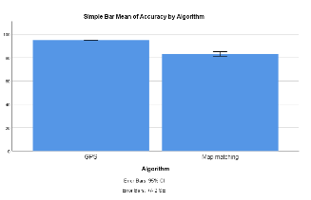
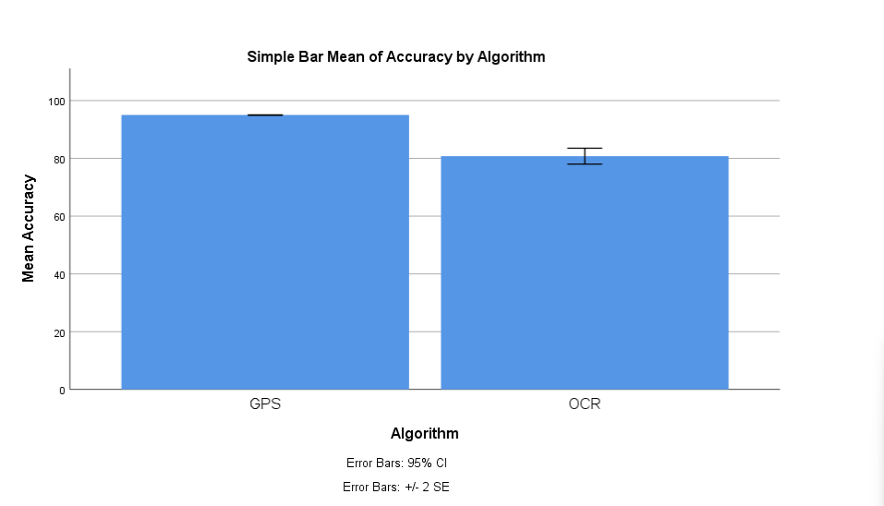
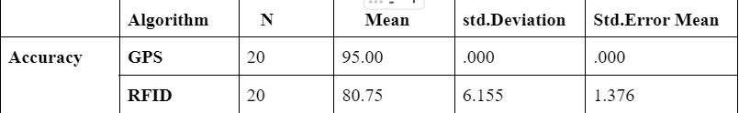
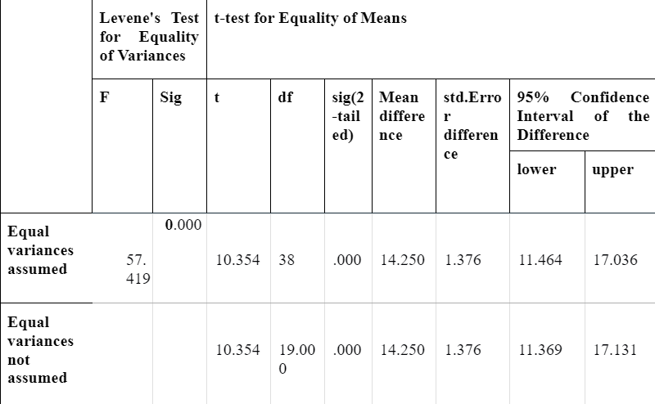
Name: Tathireddy Teja Register Number: 192110191
Guided by: Dr. D.Manikevalen
Ms. Poorani.S
Guided by Dr. Mary Valantina. G
Increase efficiency in shipment tracking system that utilizes mobile connectivity of Global positioning system(GPS) comparison with optical character recognition (OCR).
INTRODUCTION
Aim is to Increase efficiency in shipment tracking system that utilizes mobile connectivity of Global positioning system(GPS) comparison with optical character recognition (OCR).
Improve the accuracy of tracking information by leveraging GPS for location data and OCR for interpreting textual information such as shipping labels or documents.
Facilitate the tracking of raw materials and finished products within the manufacturing process, improving production efficiency..
Utilize GPS technology to track the real-time location of shipments and vehicles involved in the transportation process.
Geospatial data such as maps, routes, and points of interest to facilitate route optimization and spatial analysis.
Shipment tracking system
MATERIALS AND METHODS
Data Collection
Analytics and Reporting
GPS compared with Map Matching
Accuracy
95.00%
Data Processing
GPS Tracking
Preprocessing and Training
RESULTS
GPS and OCR
Global Positioning System (GPS) and OCR. Both algorithms were applied to 20 samples each. The mean value achieved by the Global Positioning System (GPS) was 95.00, surpassing the mean of 80.75% obtained by the OCR algorithm.
The standard deviations for the Global Positioning System (GPS) and OCR were 0.00 and 6.155 respectively. Moreover, the standard error means were 0.000 for the Global Positioning System (GPS) and 1.376 for OCR.
DISCUSSION AND CONCLUSION
The mean accuracy achieved by the GPS algorithm is significantly higher (95.47) compared to the OCR algorithm (78.95), indicating that GPS technology provides more precise location data for tracking shipments.
This higher mean accuracy suggests that GPS is better suited for applications where precise location information is crucial, such as logistics and supply chain management.
The statistical analysis further confirms the superiority of the GPS algorithm over OCR, with the independent sample t-test revealing a statistically significant difference between the two algorithms at a 95% confidence interval (p < 0.05).
This indicates that the differences in mean accuracy between GPS and OCR are unlikely to occur by chance and are indeed meaningful.
BIBLIOGRAPHY
Aleid, Fahad Abdulaziz, Simon Rogerson, and Ben Fairweather. n.d. “A Suppliers’ Perspective on E-Commerce: Suppliers Responses to Consumers' Perspectives on E-Commerce Adoption in Developing Countries — A Saudi Arabian Empirical Study.”
“Automatically Tracking Engineered Components through Shipping and Receiving Processes with Passive Identification Technologies.” 2012. Automation in Construction 28 (December): 36–44.
Azzi, G. E. 1983. “On the Nature of Credit Demand and Credit Rationing in Competitive Credit Markets.” Journal of Banking & Finance 7 (2): 273–84.
Basheer, Mohammed Rana, and S. Jagannathan. 2013. “Localization of RFID Tags Using Stochastic Tunneling.” IEEE Transactions on Mobile Computing. http://ieeexplore.ieee.org/stamp/stamp.jsp?tp=&arnumber=6175900.

